Slide 1
Biomarkers in Treating Depression with Ayahuasca
Abhranil Das (Neo) · Dráulio Araújo lab

Slide 2
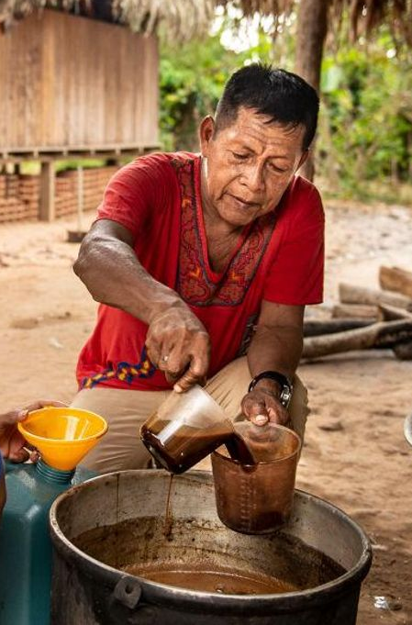
slide 2 of 12
Depression and Ayahuasca
Brazil globally ranks 5th for depression, 1st for anxiety.
30% depression patients are treatment-resistant
Ayahuasca: traditional Amazonian brew of two plants
Shows promise in treating depression

Slide 3
Questions
slide 3 of 12
Ayahuasca clinical trial
46 healthy, 29 with treatment-resistant depression
Each group split into ayahuasca and placebo
24 biomarkers collected before and after treatment
How do biomarkers differ between healthy and depressed people?
How do biomarkers change after an ayahuasca vs. placebo dose in healthy and depressed people?
Which biomarker changes correlate with improvements in the depressed people?

Slide 4
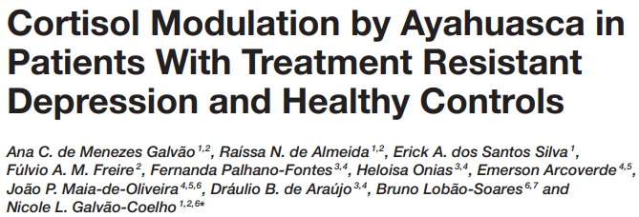
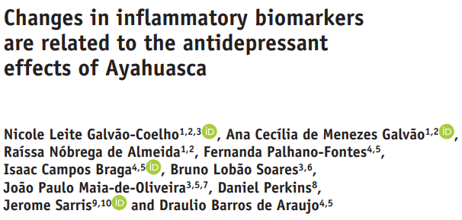
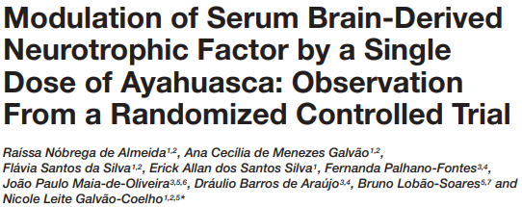
slide 4 of 12
Individual marker analysis
Salivary cortisol
C-reactive protein
BDNF
Notes:
3 papers have been published analyzing some individual markers. Now we want to do a multi-marker analysis, where information from multiple markers will be used together to answer these questions.

Slide 5
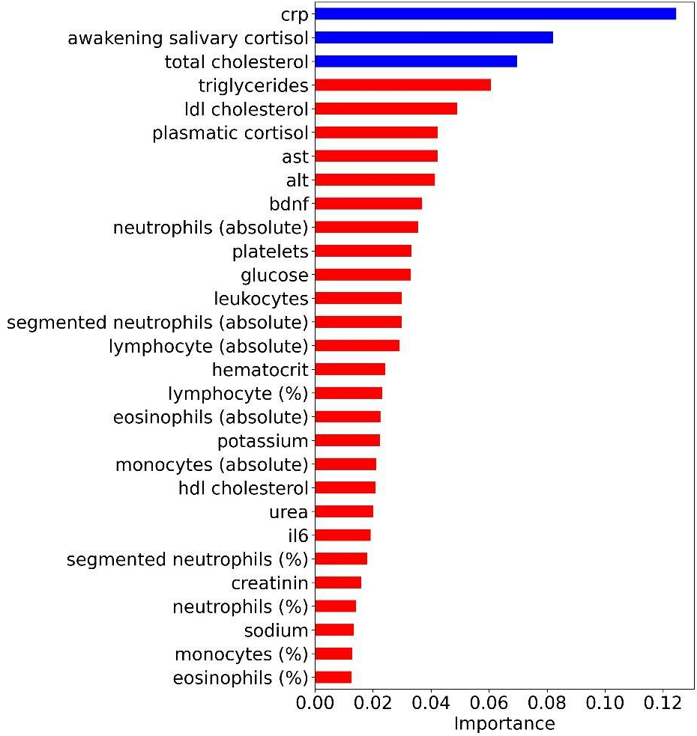
slide 5 of 12
Random Forest model

Slide 6
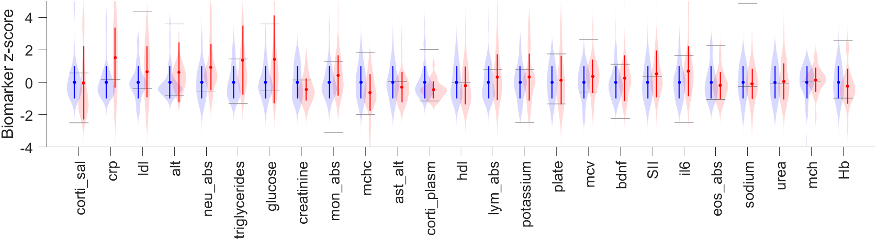
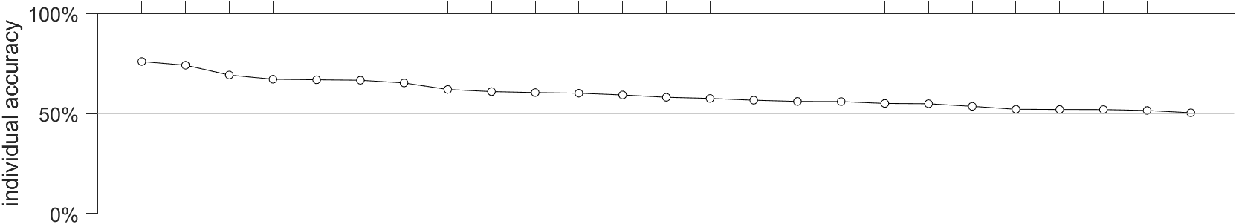
slide 6 of 12
Biomarkers at baseline
quadratic SVM
healthy depressed
Notes:
Individual marker distributions: error bars + violin plots.
Gray bars are classification boundaries using each individual marker.
When two distributions vary in mean as well as sd, the correct classification boundary is a quadratic, not a linear. It has two boundaries, not one.
The classification accuracy is plotted below, and the markers have been sorted by this.
Corti_sal, crp and ldl are the top 3 individual markers in distinguishing H from D.

Slide 7
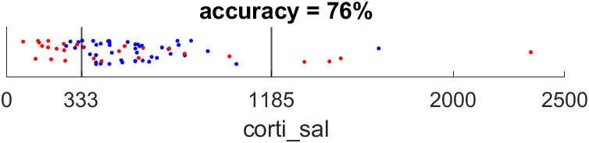
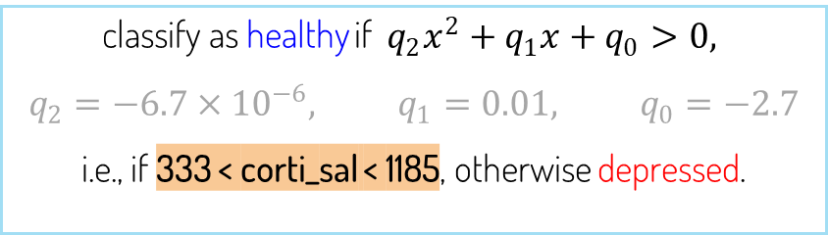
slide 7 of 12
Classifying using only the best marker: salivary cortisol
healthy depressed
classify as healthy if $q_{2}x^{2}+q_{1}x+q_{0}>0,$
$$q_{2}=−6.7×{10}^{−6}, q_{1}=0.01, q_{0}=−2.7$$
i.e., if 333 < corti_sal < 1185, otherwise depressed.
Multiple studies: depressed have lower avg. corti_sal, but also more spread. So both lower and higher than healthy.
Cortisol provides drive upon waking. Too little: fatigue. Too much: anxiety/stress.
Compare to random forest: transparent model, interpretable classification rules, yields insight.
Notes:
The random forest is a collection of decision trees, whose decision is averaged. So no human-interpretable classification rule based on the markers. We’re not getting much insight into how and why the markers are being used to separate H and D.

Slide 8
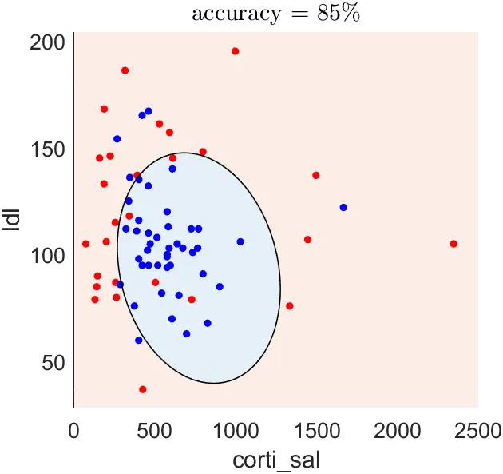
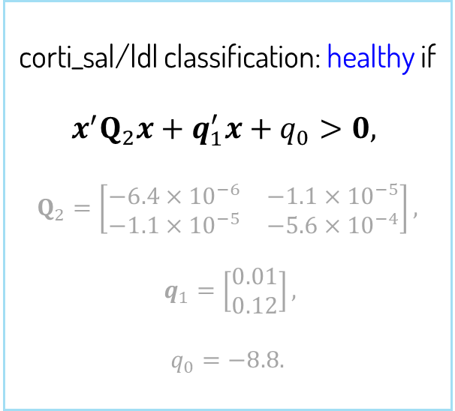
Adding the second-best marker: LDL cholesterol
slide 8 of 12
corti_sal/ldl classification: healthy if
$$x^{′}Q_{2}x+q_{1}^{′}x+q_{0}>0,$$
$$Q_{2}=\left[\begin{matrix}−6.4×{10}^{−6} & −1.1×{10}^{−5} \\ −1.1×{10}^{−5} & −5.6×{10}^{−4}\end{matrix}\right],$$
$$q_{1}=\left[\begin{matrix}0.01 \\ 0.12\end{matrix}\right],$$
$$q_{0}=−8.8.$$
healthy
depressed
A stressed body releases energy into blood to prep for action. If unused, it accumulates as LDL.
Although CRP is the second-best individual marker, LDL narrowly beats it when combined with corti_sal.
Only new info counts.
Combining features gives different results than looking at them individually.
Compare to RF: see how markers interact in the decision space.
Notes:
WHAT IS X

Slide 9
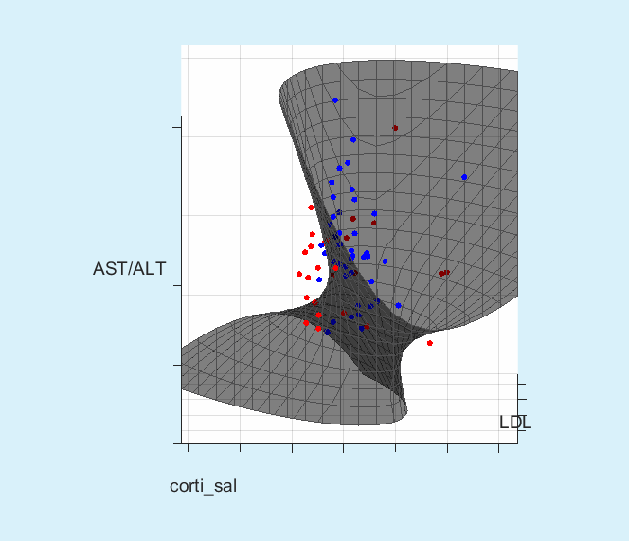
slide 9 of 12
Adding the third-best marker: AST/ALT
accuracy = 87%
healthy
depressed
Depressed people have lower AST/ALT ratio.
Associated with a stressed liver.
Immunometabolic depression

Slide 10
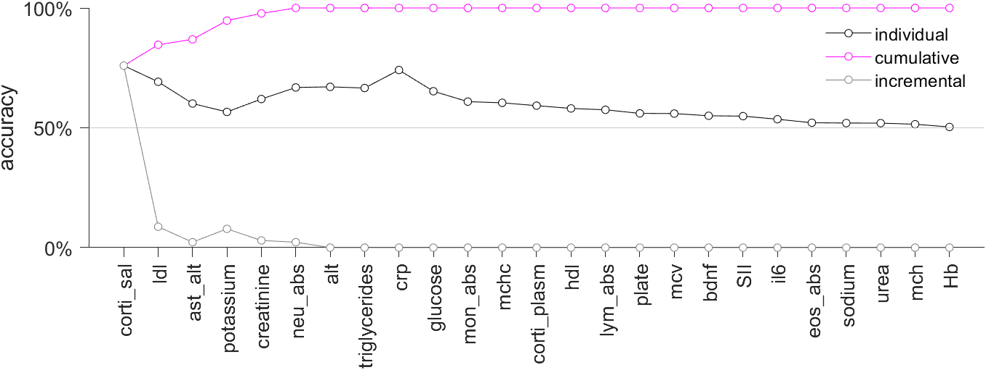
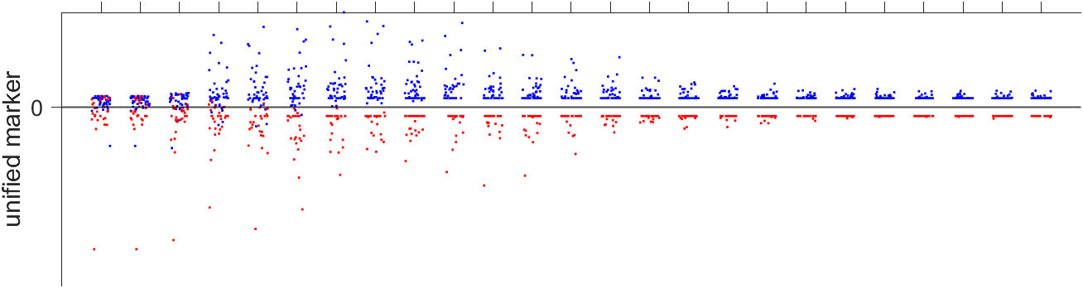
Greedily accumulating markers
slide 10 of 12
100% accuracy with 6 markers.
Random forest said CRP was best, second-best here, paper about CRP
CRP not even top 6 here
Caveat: train vs test
A single marker for classifying healthy/depressed
healthy depressed

Slide 11
slide 11 of 12
Summary
We analyzed biomarkers collected during an ayahuasca clinical trial
Using SVM, we showed how well they distinguish healthy from depressed, both individually and combined
This is a transparent method that yields insight
Future work: apply these methods to the other questions

Slide 12

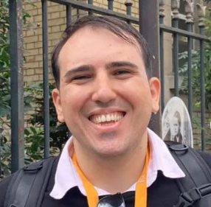
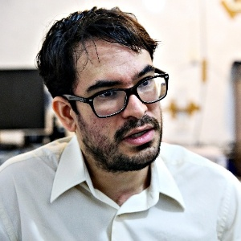

slide 12 of 12
Thanks
Fernanda Palhano-fontes
Inácio Gomes Medeiros
Sergio Mota-Rolim

